Slide 1
The perfect storm

Slide 2
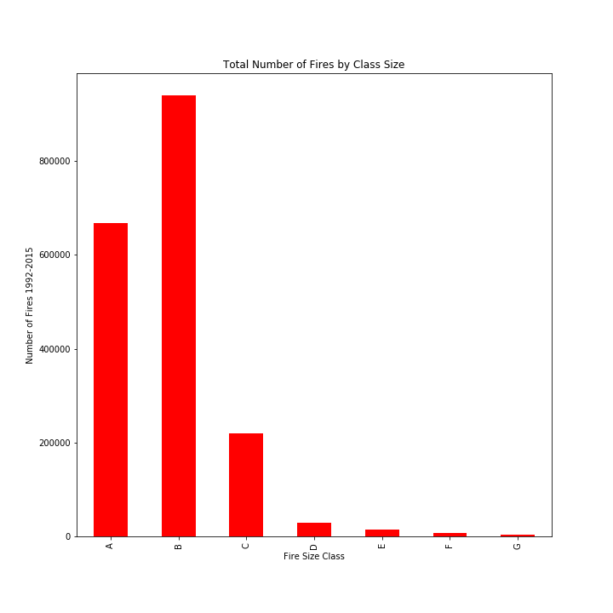

Slide 3
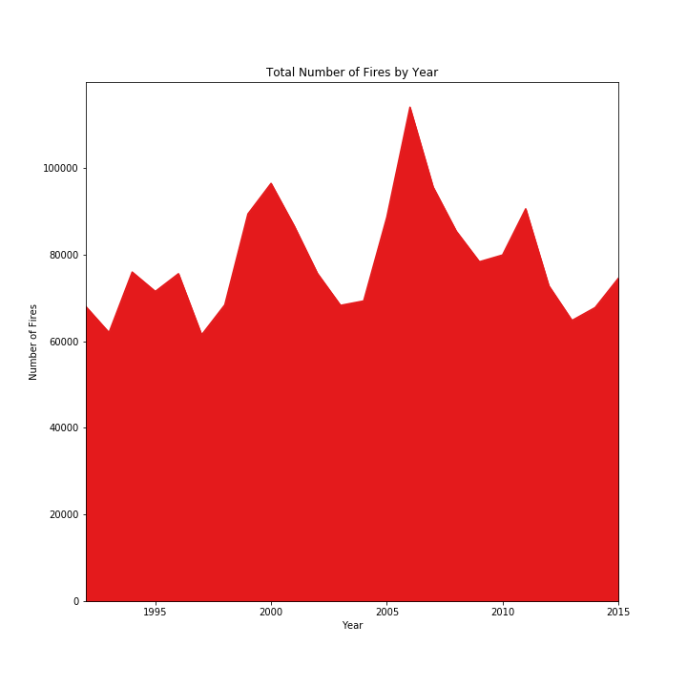

Slide 4
